Slide 1






My Journey
Vishal Kannan
2020 – Integrated Master’s in Bioengineering and Medical Nanotechnology
Experience: Biomedical instrumentation, signal processing, tissue engineering and 3D printing
Neurobiology and cognitive sciences, Physiological control systems
Why do we behave in a certain way??
2024 – Master’s in Integrative Neuroscience
- Systems, behaviour and theoretical neuroscience
- Research Assistant/ Master thesis in CortXplorer group, Leibniz Institute for Neurobiology, Magdeburg, Germany
Present – PhD at deHoz lab @ deHoz lab (Since April 1st , 2024)
Neural computation and behaviour
Notes:
Start with who you are and why you are here!
-- Recent masters graduate looking for PhD options, met Daniela at imbizo and got super interested in her work. A bit about my background,

Slide 2


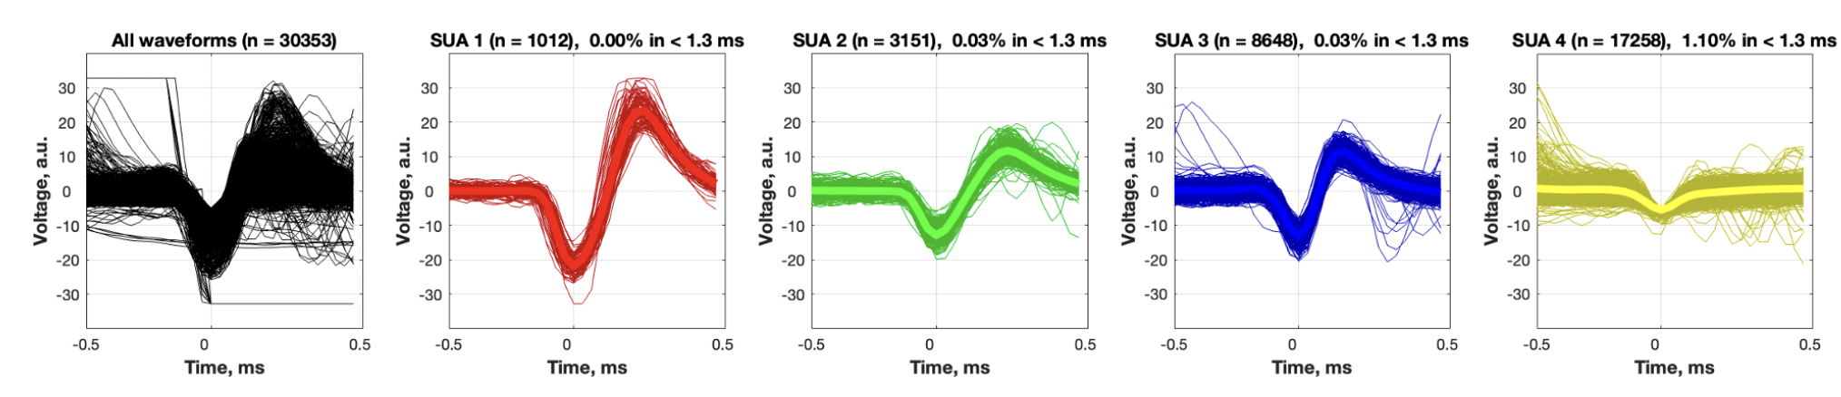


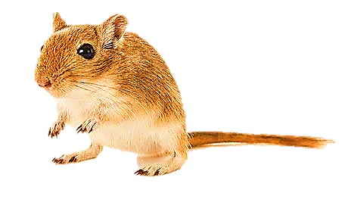
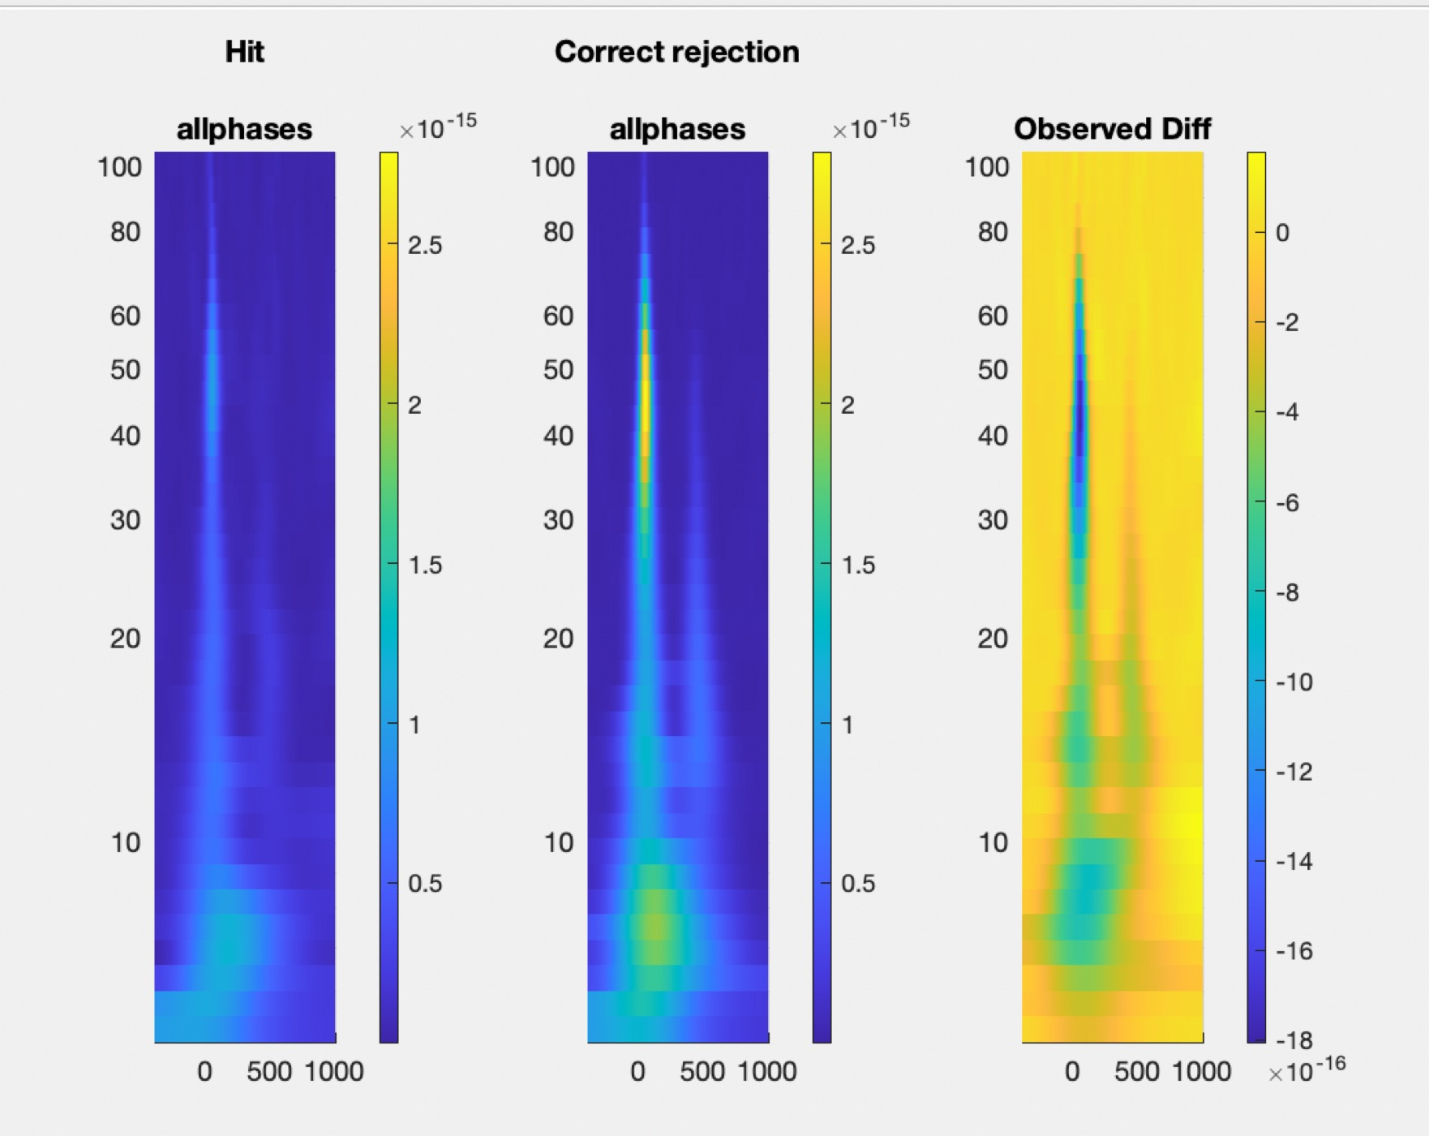
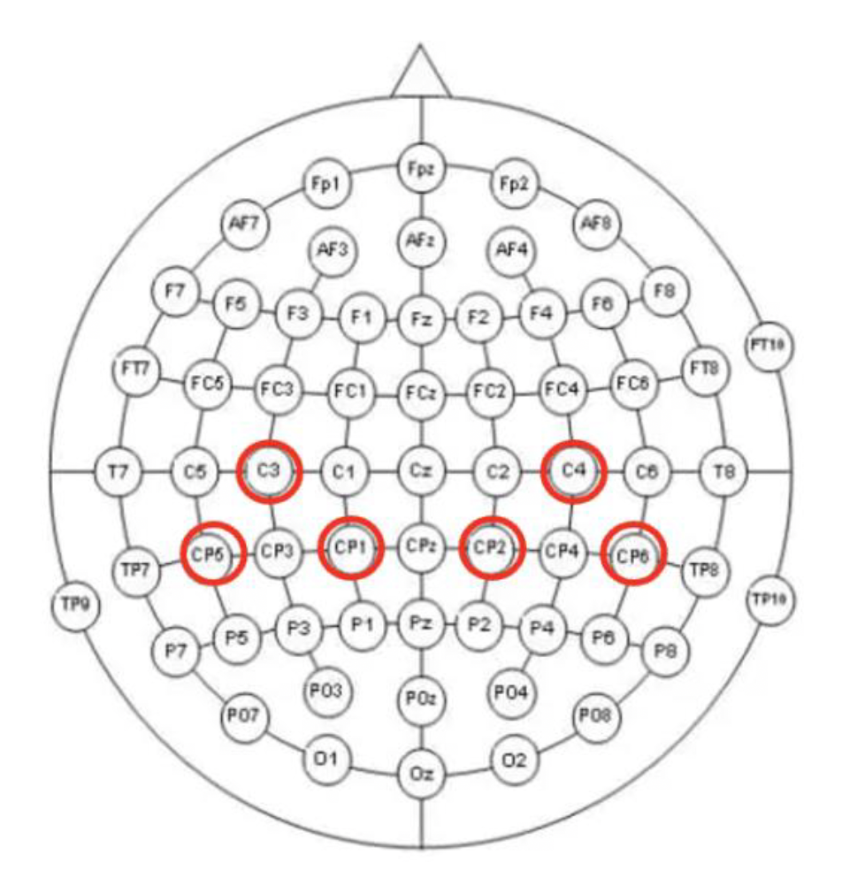


Research experience
Offline spike sorting
How does altering single-cell and population-level activity affect a monkey’s working memory?
Learning and memory
Spatial audio setup with a software interface
Sensory perception
How does sound localization help in perceiving spatial audio?
How does sensory integration in a Gerbil’s auditory cortex guide an animal’s decision in a changing environment? (Auditory reversal learning)
Linear array of speakers
Cognitive flexibility
Time frequency analysis
Supervised learning – movement intention and movement
Clinical rehabilitation
Potential classification feature to design a brain-computer interface for post-stroke rehabilitation
Adaptive decision making
How do neuronal activity patterns in the frontal cortex shape an animal’s adaptive decision-making behaviour in a foraging task?
Master thesis

Slide 3
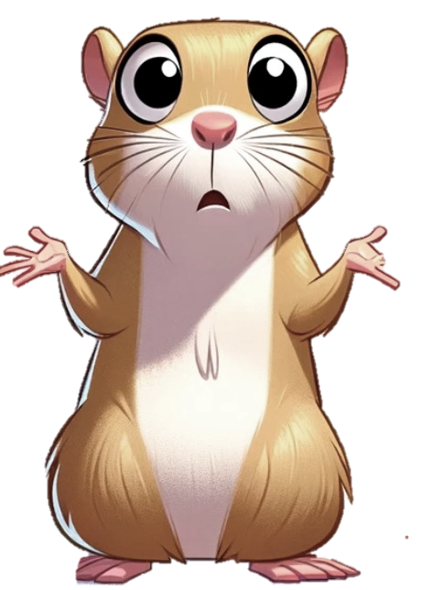
Should I stay or should I go?
Exploitation
Exploration
Navigating Uncertainty: Neural Mechanisms of Probabilistic Foraging in Mongolian Gerbils
Master’s Thesis
by
Vishal Kannan
Supervisor: Prof. Dr. Max Happel
Notes:
Start with a humor about should I stay or should I go?

Slide 4
Master thesis - Objectives

Slide 5
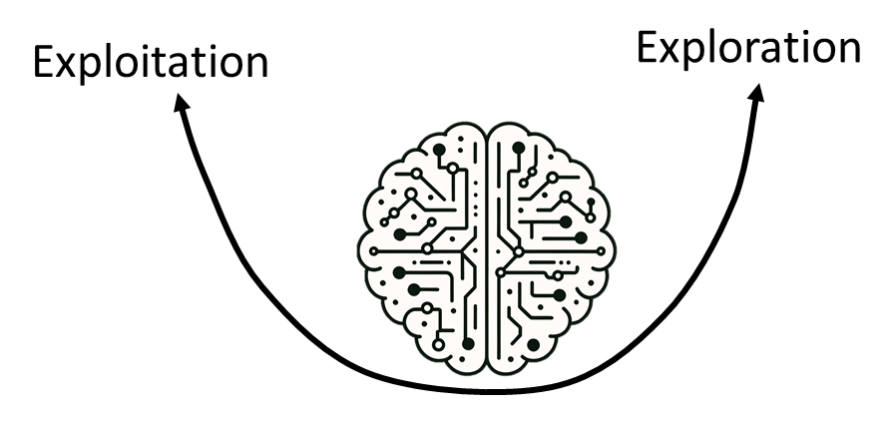
Master thesis - Objectives
Neuronal circuit functions in frontal cortex – exploitative vs explorative strategies

Slide 6
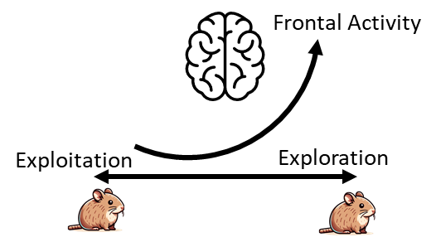
Neuronal circuit functions in frontal cortex – exploitative vs explorative strategies
frontal activity before patch leaving decision
Master thesis - Objectives

Slide 7
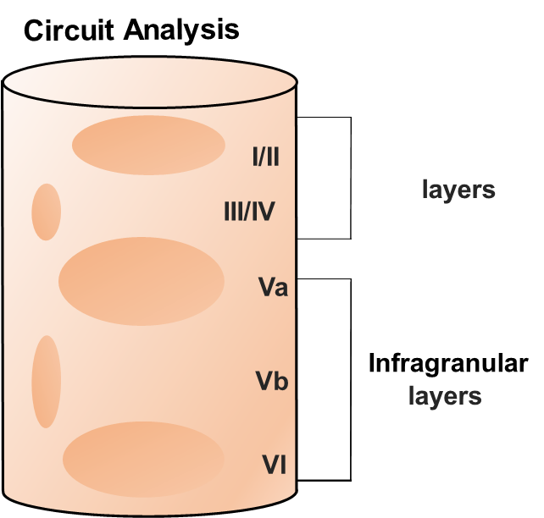
Neuronal circuit functions in frontal cortex – exploitative vs explorative strategies
frontal activity before patch leaving decision
Master thesis - Objectives
Layer-dependent processing

Slide 8
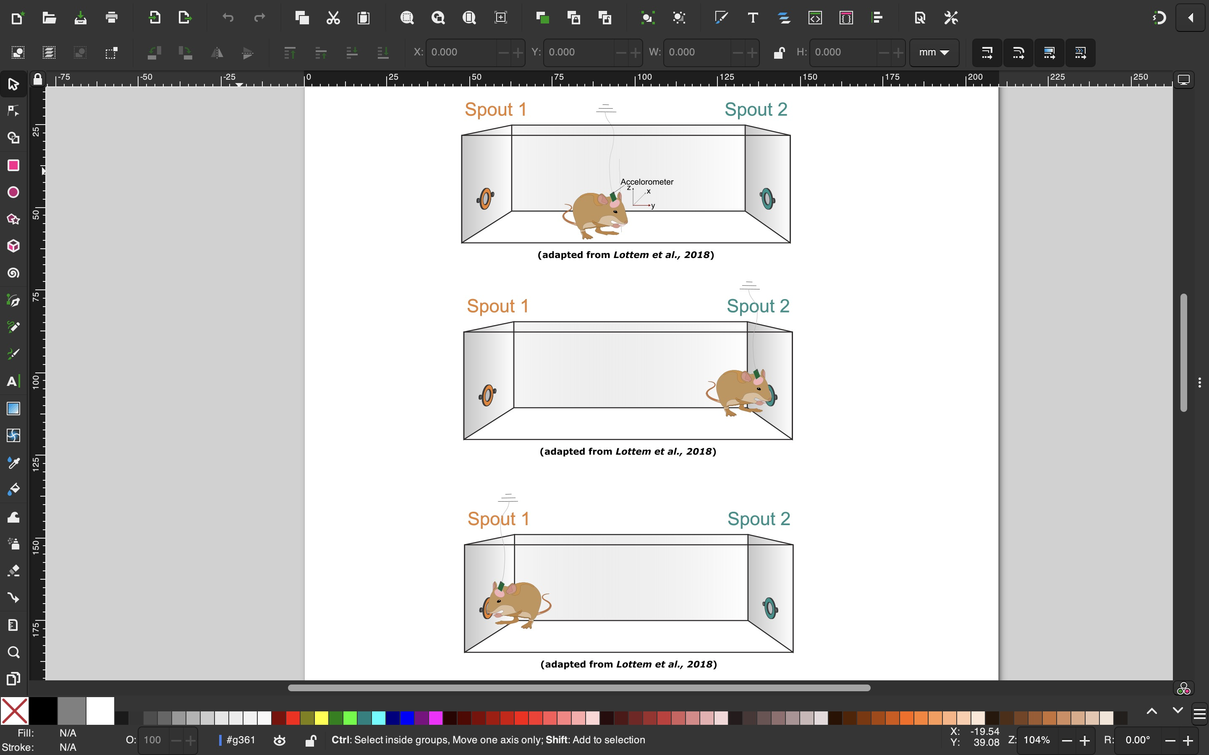
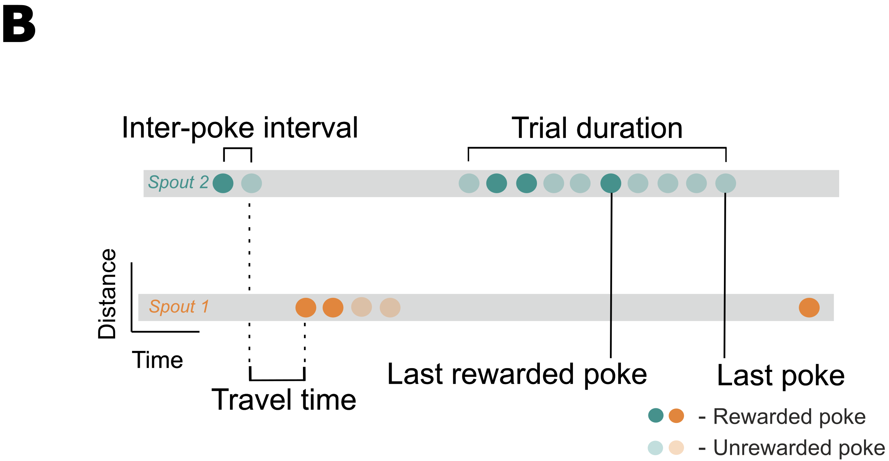
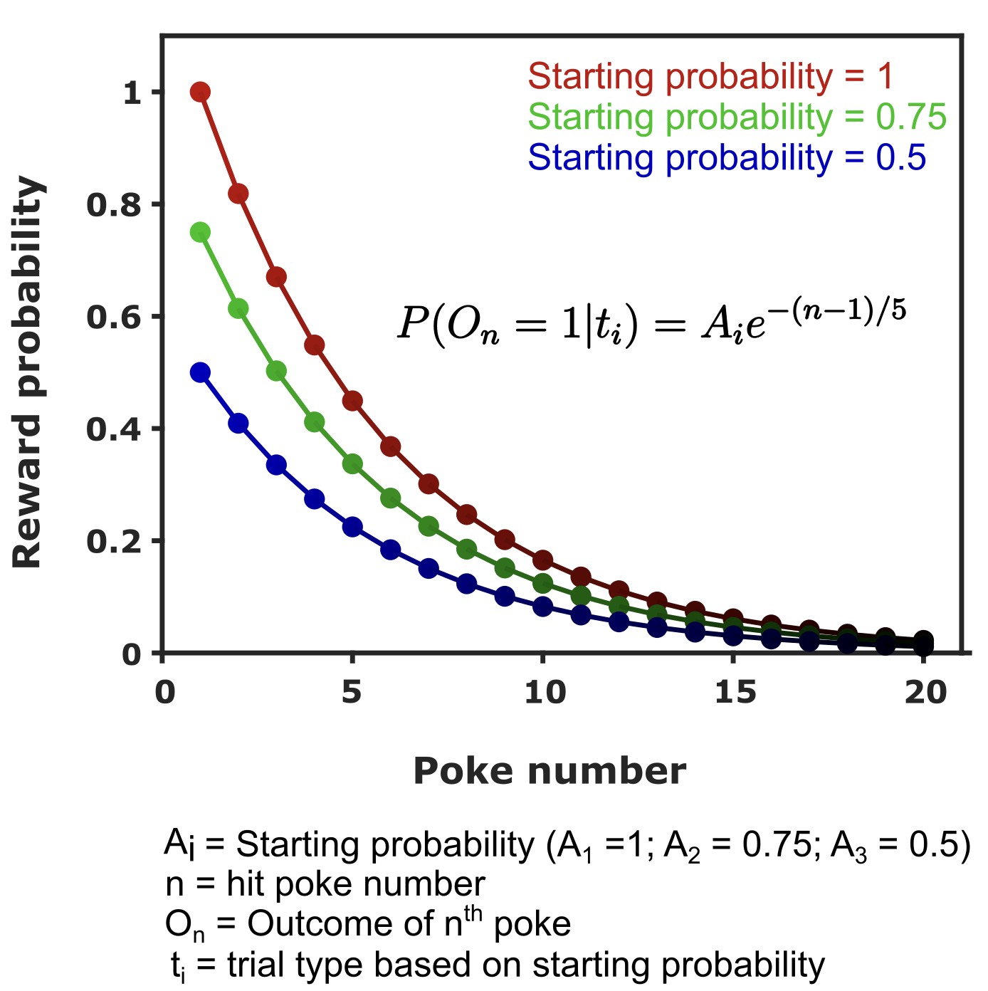

Master thesis – The probabilistic foraging task
1. Exponential decay of reward probability
2. Dynamic starting reward probability
?

Slide 9
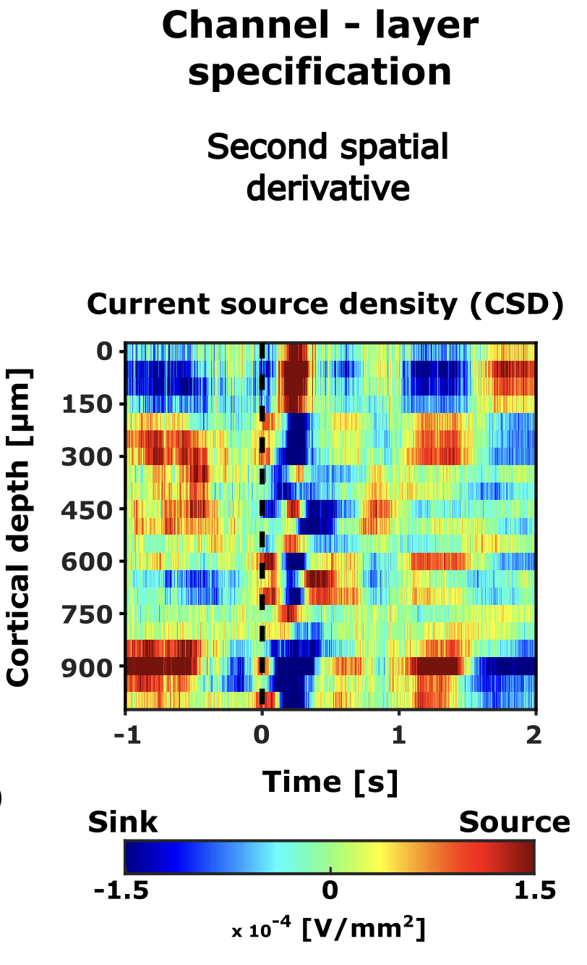
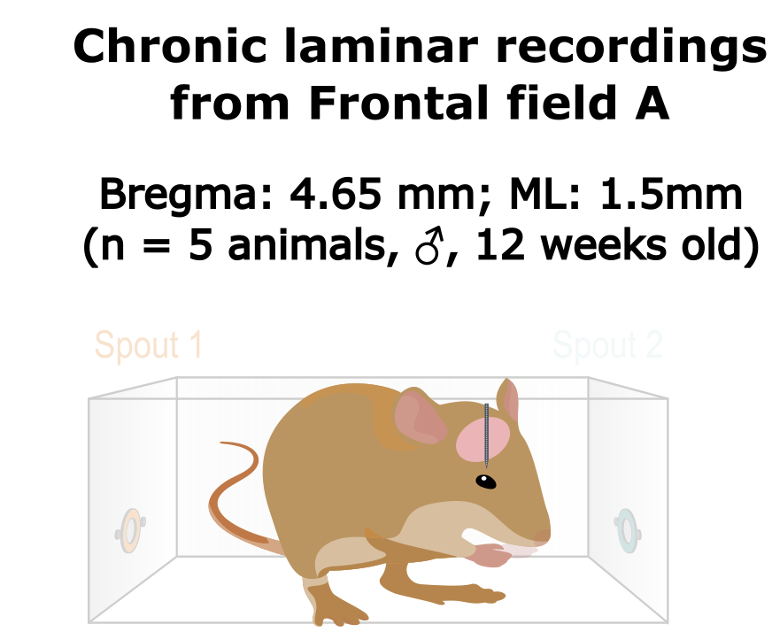
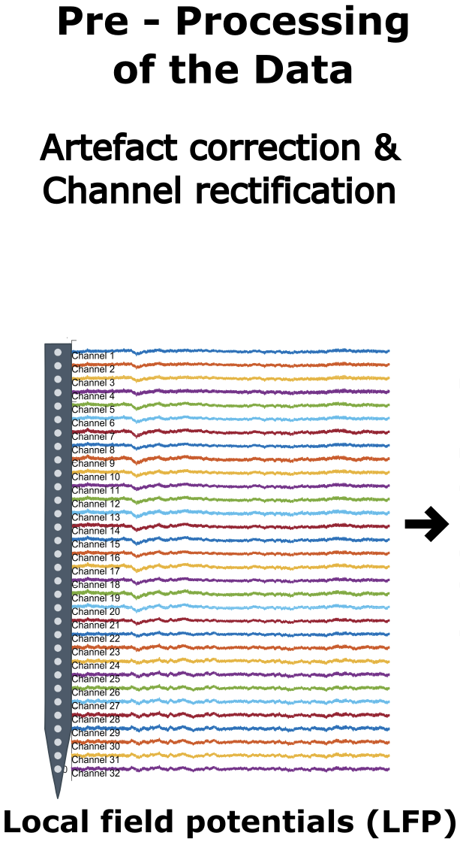
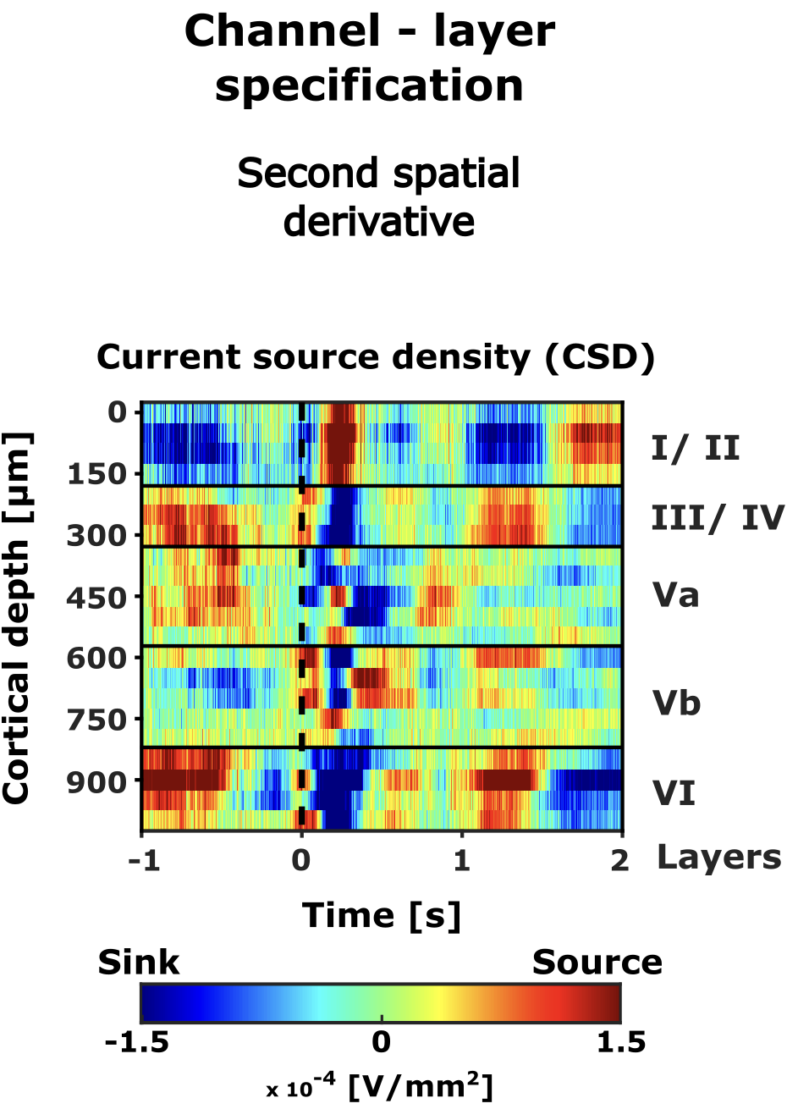
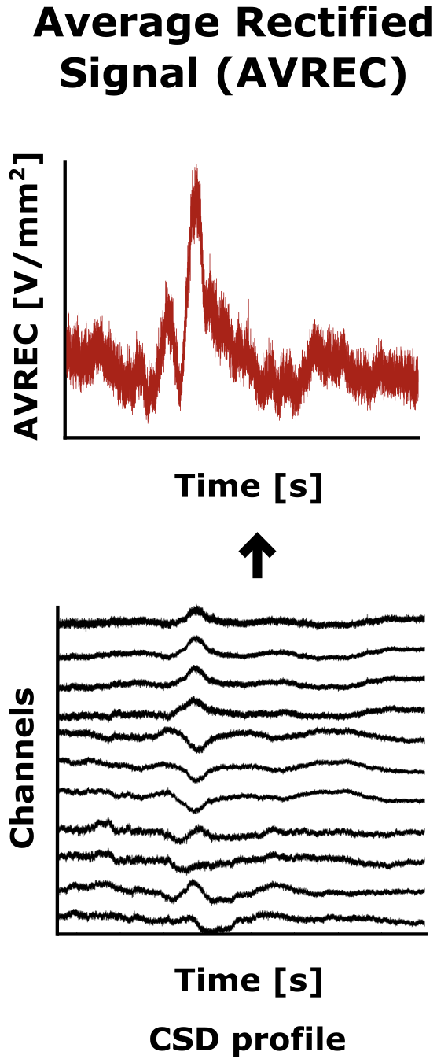

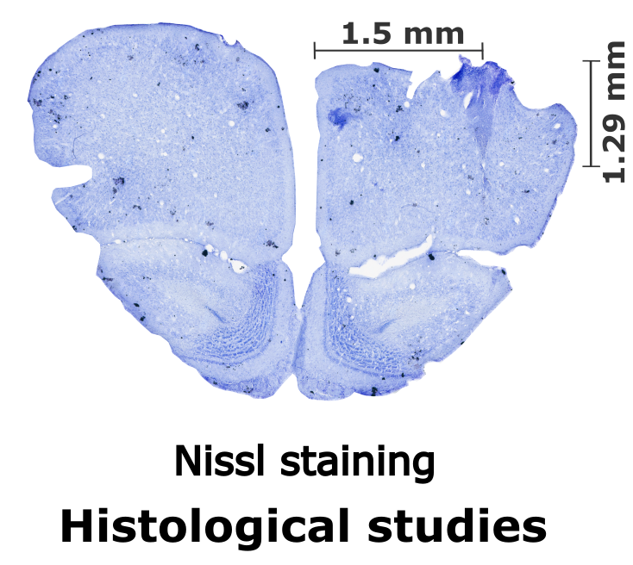
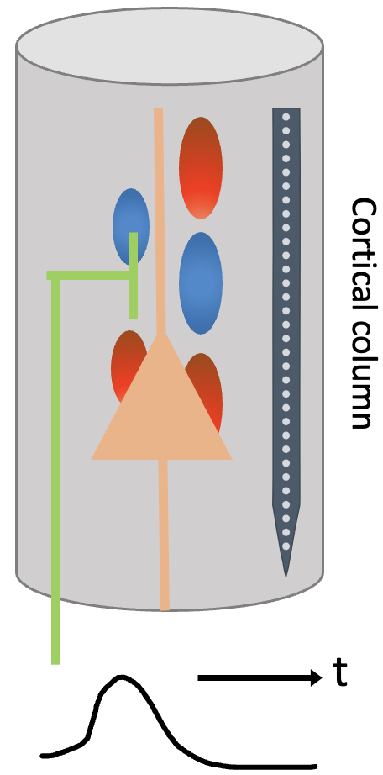
Master thesis – How did we study this?
Overall frontal activity
Average across layers
Average across channels

Slide 10
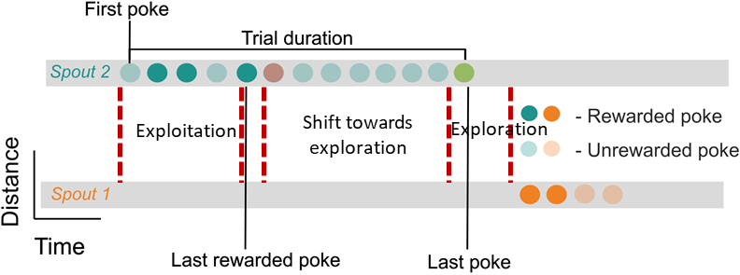

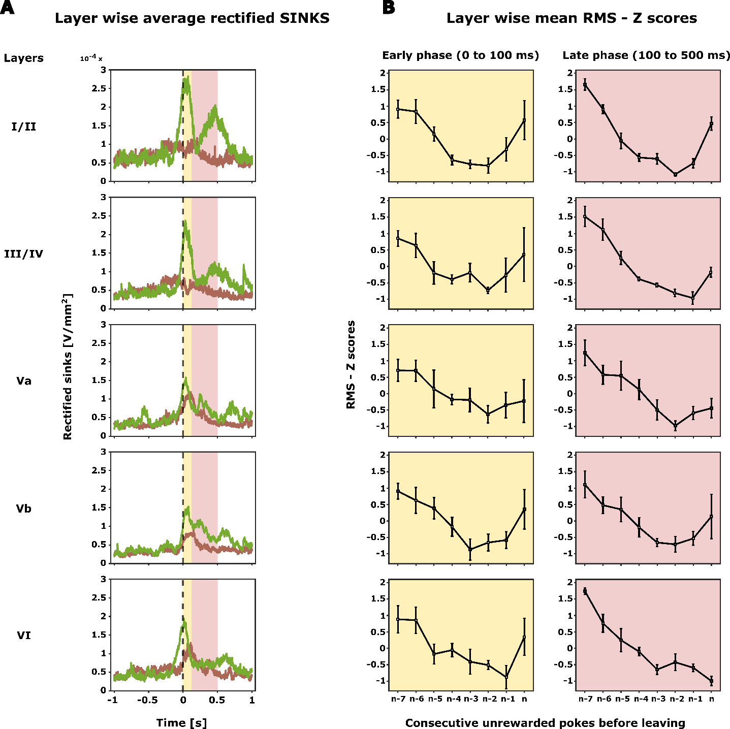
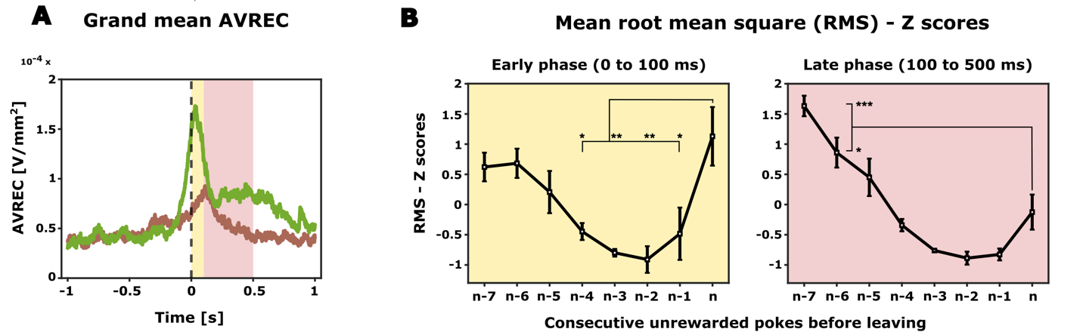
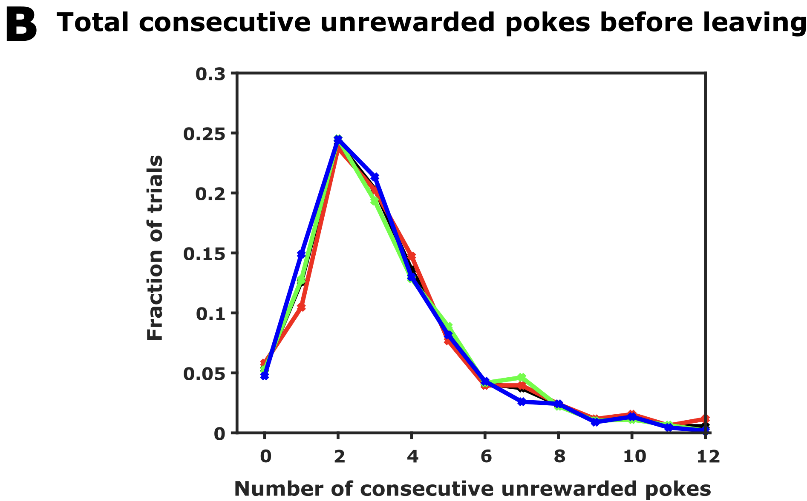
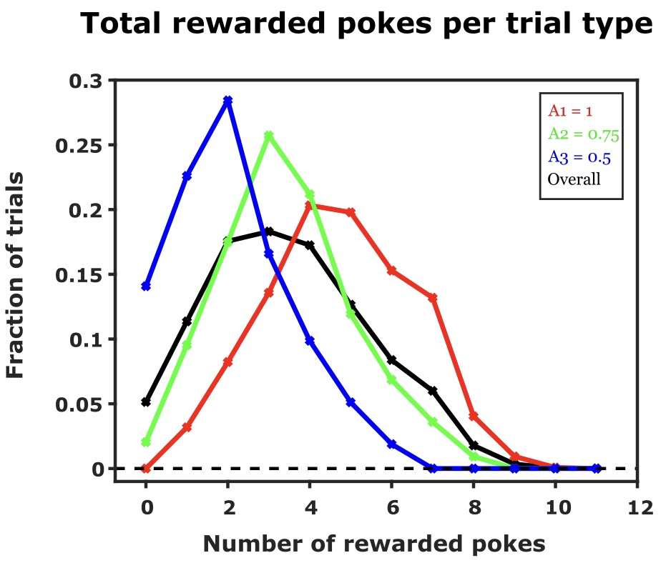
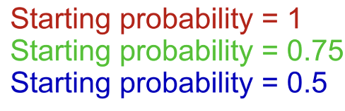
Master thesis – Main findings
Optimal decision-making behaviour
Increase in overall frontal activity before spout-leaving
Layer-dependent processing
Hypothesis
Total consecutive unrewarded pokes before leaving
Exploitation → Exploration = Deeper → superficial layers
Increase in overall frontal activity just before the animal decides to explore
Animals adopt an optimal strategy by forming an inference about hidden probabilities
Exploitation to exploration → Evidence accumulation (Alteration of current expectations)
Decisive role by altering current expectation and adopting adequate search strategies

Slide 11
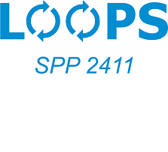

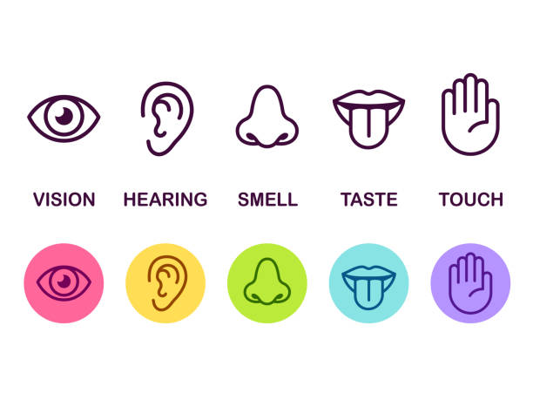


My Journey
Present – PhD in Computational Neuroscience
Temporal dynamics of unsupervised contextual learning in cortico-collicular loops
deHoz Lab
Dr. Livia de Hoz
Contextual learning
Pre-attentive manner
Little understanding of the auditory circuits that participate in the learning and coding of contextual sounds.
Notes:
A complex process such as contextual processing is likely to occur simultaneously at several interacting levels of the auditory system in a time- and task-dependent manner, possibly over progressively wider integration time-windows.

Slide 12
My Journey
Present – PhD in Computational Neuroscience
Temporal dynamics of unsupervised contextual learning in cortico-collicular loops
deHoz Lab
Dr. Livia de Hoz
Contextual learning
Foreground-background segregation
1. Filter out random background noise that is embedded within a series of sound sequences
2. Adapt to different background noises with stationary statistics (e.g. Ventilation sound, waterfalls)
Notes:
A complex process such as contextual processing is likely to occur simultaneously at several interacting levels of the auditory system in a time- and task-dependent manner, possibly over progressively wider integration time-windows.

Slide 13
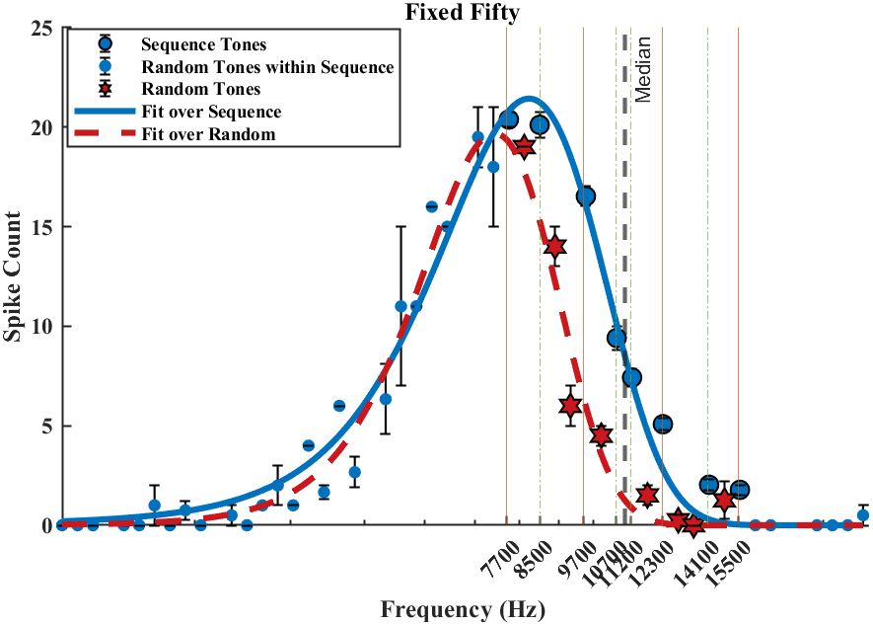

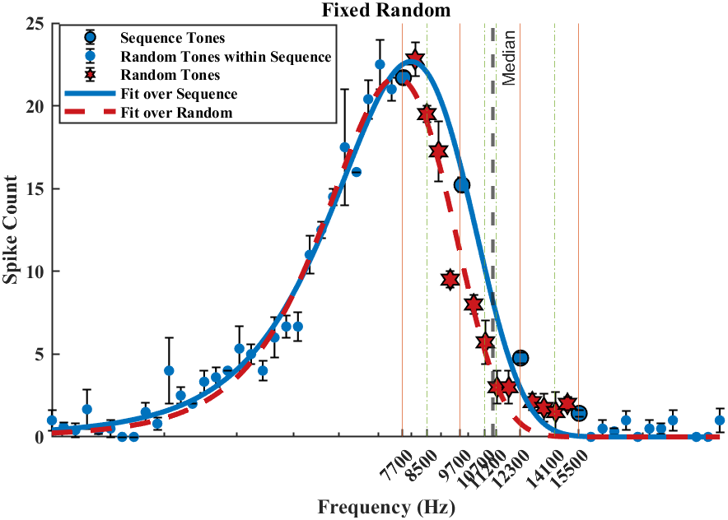
My Journey
Present – PhD in Computational Neuroscience
Temporal dynamics of unsupervised contextual learning in cortico-collicular loops
deHoz Lab
Dr. Livia de Hoz
Sequence tones
Random tones (noise)
1. Filter out random background noise that is embedded within a series of sound sequences
Frequency (Hz)
Neuropixels recordings from anaesthetized mouse IC
Designed protocols to study context segregation in rodents
Position in time
Inferior colliculus → unsupervised contextual learning
Segregates noise from the sequence
(Cruces-Solís et al., 2018, Chen et al., 2023)
Notes:
Two times repeat an
A complex process such as contextual processing is likely to occur simultaneously at several interacting levels of the auditory system in a time- and task-dependent manner, possibly over progressively wider integration time-windows.
distinguishes between prediction error signals triggered by noise (to be suppressed) rather than surprise (to be attended)

Slide 14
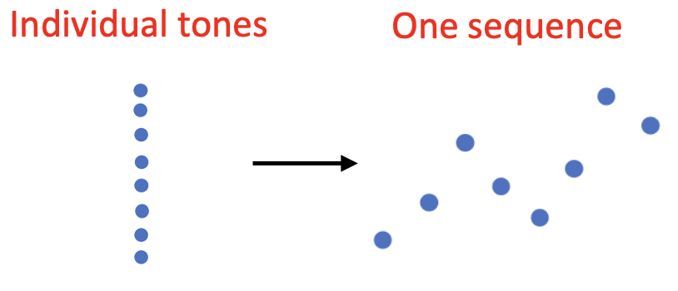
Present – PhD in Computational Neuroscience
Broader objectives
1. Processing strategies within IC
Salient vs non-salient prediction errors?
2. Neural dynamics of sensory representation
3. Cortico-collicular interactions in auditory contextual learning and representation
Role of cortical inhibition on IC
Notes:
Task specific RNNs?
1. How are individual tones, when repeated in a specific sequence, initially represented in the auditory system, and how does this representation evolve as they are integrated into a cohesive sound sequence over time?
2. How is the representation of sound sequences maintained stably in the IC and AC while selectively attenuating the representation of noise?
3. In what ways do cortico-collicular interactions influence the learning and representation of auditory sequences?
Stability Analysis: Examining the stability of these trajectories, such as identifying fixed points (where the state ceases to change) and analyzing their stability (how the system behaves when perturbed slightly), can provide insights into the network’s ability to learn and generalize. For instance, stable fixed points may represent learned patterns or features of the data.
Why not input the sound sequences itself?
How many trials do I require minimum to train this RNN?
Provides a comprehensive view that combines neural activity data with dynamic modeling to elucidate the principles of auditory perception and learning. This framework not only complements experimental work by providing a means to interpret and predict neural behavior but also pushes forward the understanding of complex neural networks in a functionally relevant context.

Slide 15
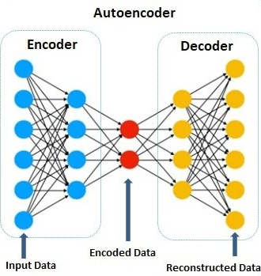
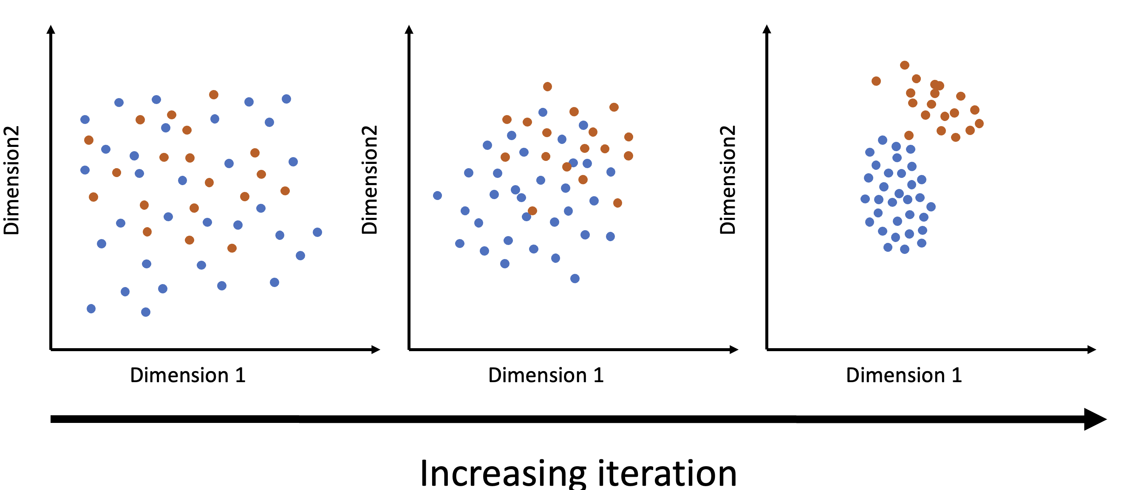
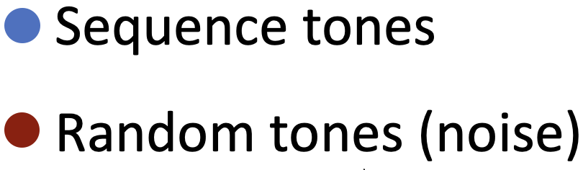
Present – PhD in Computational Neuroscience
Objectives
How do we study it?
Outcome
(Neural data analysis and computational modelling)
Task-specific RNN (Model 1 – auditory input)
1. Identify the processing strategies within IC
Incorporating the learning rule of Kalman filter – Uncertainty estimation, Adaptive learning rate and de-emphasizing noise
mimic the pre-attentive stages of fundamental auditory processing at the level of IC – theoretical framework of learning
Predict IC responses (Different sequences → Two sequences (Galloping sequence), and more naturalistic sounds in background
Noise gets segregated
RNN autoencoder (Model 2 – neural data input)
underlying neural dynamics
2. Temporal dynamics and stability of neural sensory representation
Dynamical systems analysis
Latent State Representation and stability analysis
Noise invariant representation of sound sequences
Cross correlation, Granger Causality, Phase coherence
Network model between IC and A1 – study the effect of cortical inhibition on IC
3. Analysis and modelling of cortical feedback to IC
Role of cortical inhibition on contextual learning in IC during different time scales
Cortical inhibition on IC
Theoretical/computational framework for unsupervised auditory contextual learning within IC and A1`
Notes:
Task specific RNNs?
1. How are individual tones, when repeated in a specific sequence, initially represented in the auditory system, and how does this representation evolve as they are integrated into a cohesive sound sequence over time?
2. How is the representation of sound sequences maintained stably in the IC and AC while selectively attenuating the representation of noise?
3. In what ways do cortico-collicular interactions influence the learning and representation of auditory sequences?
Stability Analysis: Examining the stability of these trajectories, such as identifying fixed points (where the state ceases to change) and analyzing their stability (how the system behaves when perturbed slightly), can provide insights into the network’s ability to learn and generalize. For instance, stable fixed points may represent learned patterns or features of the data.
Why not input the sound sequences itself?
How many trials do I require minimum to train this RNN?
Provides a comprehensive view that combines neural activity data with dynamic modeling to elucidate the principles of auditory perception and learning. This framework not only complements experimental work by providing a means to interpret and predict neural behavior but also pushes forward the understanding of complex neural networks in a functionally relevant context.

Slide 16
Thank you
?
Questions

Slide 17

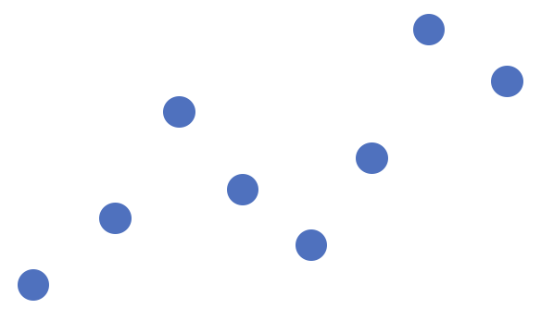
Present – PhD in Computational Neuroscience
Main Objectives
How do we study it?
1. Temporal Dynamics of Sensory Representation
Neural data analysis (IC and A1)
Data driven computational modelling
Individual tones
One sequence
Spike sorting and Dimensionality reduction techniques (e.g., PCA)
RNN autoencoder
Dynamical systems analysis
Latent State Representation and stability analysis
2. Noise Invariant Representation of Sound Sequences
Incorporating Kalman filter framework – Adaptive learning rate and de-emphasizing noise
Stability of sensory representation
Cross correlation, Granger Causality, Phase coherence
Network model between IC and A1 – study the effect of cortical inhibition on IC
3. Cortico-Collicular Interactions in Auditory Learning and Representation
Cortical inhibition on IC
Next steps → Two sequences (Galloping sequence), and more naturalistic sounds in background
Theoretical/computational framework for unsupervised auditory contextual learning within IC and A1
Notes:
Task specific RNNs?
1. How are individual tones, when repeated in a specific sequence, initially represented in the auditory system, and how does this representation evolve as they are integrated into a cohesive sound sequence over time?
2. How is the representation of sound sequences maintained stably in the IC and AC while selectively attenuating the representation of noise?
3. In what ways do cortico-collicular interactions influence the learning and representation of auditory sequences?
Stability Analysis: Examining the stability of these trajectories, such as identifying fixed points (where the state ceases to change) and analyzing their stability (how the system behaves when perturbed slightly), can provide insights into the network’s ability to learn and generalize. For instance, stable fixed points may represent learned patterns or features of the data.
Why not input the sound sequences itself?
How many trials do I require minimum to train this RNN?
Provides a comprehensive view that combines neural activity data with dynamic modeling to elucidate the principles of auditory perception and learning. This framework not only complements experimental work by providing a means to interpret and predict neural behavior but also pushes forward the understanding of complex neural networks in a functionally relevant context.

Slide 18
Present – PhD in Computational Neuroscience
Main Objectives
Specific Questions
1. Temporal Dynamics of Sensory Representation
What processing strategies within IC adopt to distinguish between prediction error signals triggered by noise (to be suppressed) rather than surprise (to be attended) ? (Task-specific RNN models with Kalman gain (biologically plausible)
Individual tones
One sequence
What are the temporal dynamics of neural representations within the IC and A1?
2. Noise Invariant Representation of Sound Sequences
How does the stability of neural representations in the IC change with varying sound sequences and noise levels?
3. Cortico-Collicular Interactions in Auditory Learning and Representation
Cortical inhibition on IC
Notes:
Task specific RNNs?
1. How are individual tones, when repeated in a specific sequence, initially represented in the auditory system, and how does this representation evolve as they are integrated into a cohesive sound sequence over time?
2. How is the representation of sound sequences maintained stably in the IC and AC while selectively attenuating the representation of noise?
3. In what ways do cortico-collicular interactions influence the learning and representation of auditory sequences?
Stability Analysis: Examining the stability of these trajectories, such as identifying fixed points (where the state ceases to change) and analyzing their stability (how the system behaves when perturbed slightly), can provide insights into the network’s ability to learn and generalize. For instance, stable fixed points may represent learned patterns or features of the data.
Why not input the sound sequences itself?
How many trials do I require minimum to train this RNN?
Provides a comprehensive view that combines neural activity data with dynamic modeling to elucidate the principles of auditory perception and learning. This framework not only complements experimental work by providing a means to interpret and predict neural behavior but also pushes forward the understanding of complex neural networks in a functionally relevant context.

Slide 19
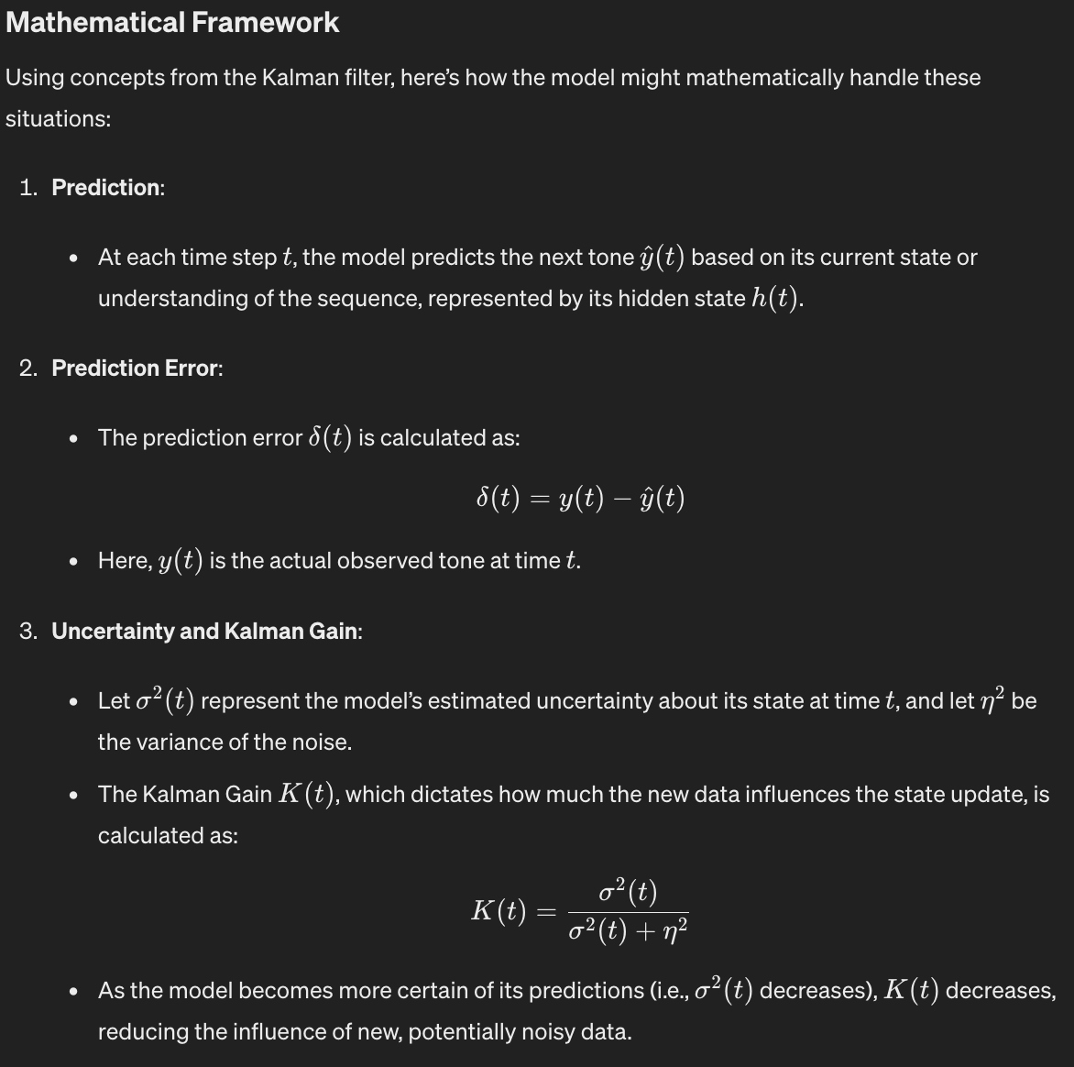
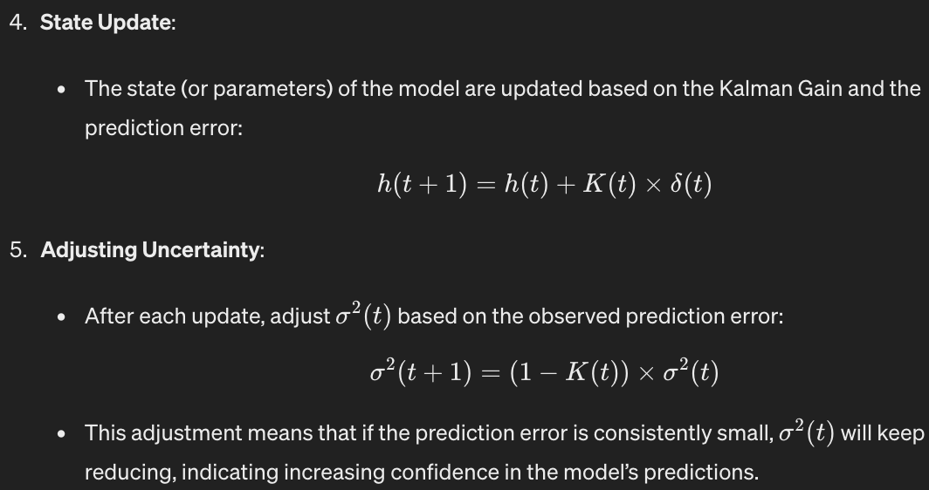


Slide 20
Task-specific RNN (trained with auditory sequence)
Neural data driven RNN model (trained with neural spike response)
mimic the pre-attentive stages of fundamental auditory processing at the level of IC
distinguishes between prediction error signals triggered by noise (to be suppressed) rather than surprise (to be attended)
Can be tested with different sets of sequences and predict the responses of IC. This can then be empirically verified with the actual experimental data.
underlying neural dynamics, such as how individual tones are integrated into cohesive sequences and how noise is selectively attenuated
stability analysis – to understand how neural representations remain stable over time despite the potential presence of noise.

Slide 21
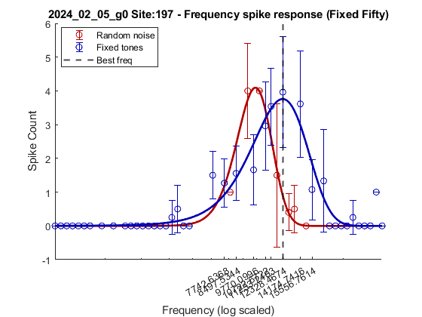
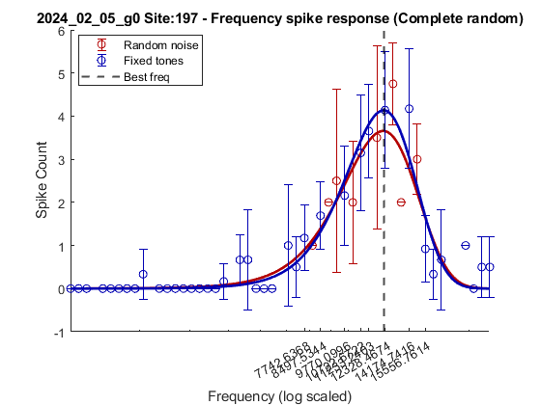
My Journey
Present – PhD in Computational Neuroscience
Temporal dynamics of unsupervised contextual learning in cortico-collicular loops
deHoz Lab
Dr. Livia de Hoz
Sequence tones
Random tones (noise)
1. Filter out random background noise that is embedded within a series of sound sequences
Frequency (Hz)
Neuropixel recordings from anaesthetized mouse IC
Position in time
Inferior colliculus → unsupervised contextual learning
(Cruces-Solís et al., 2018, Chen et al., 2023)
Notes:
A complex process such as contextual processing is likely to occur simultaneously at several interacting levels of the auditory system in a time- and task-dependent manner, possibly over progressively wider integration time-windows.

Slide 22
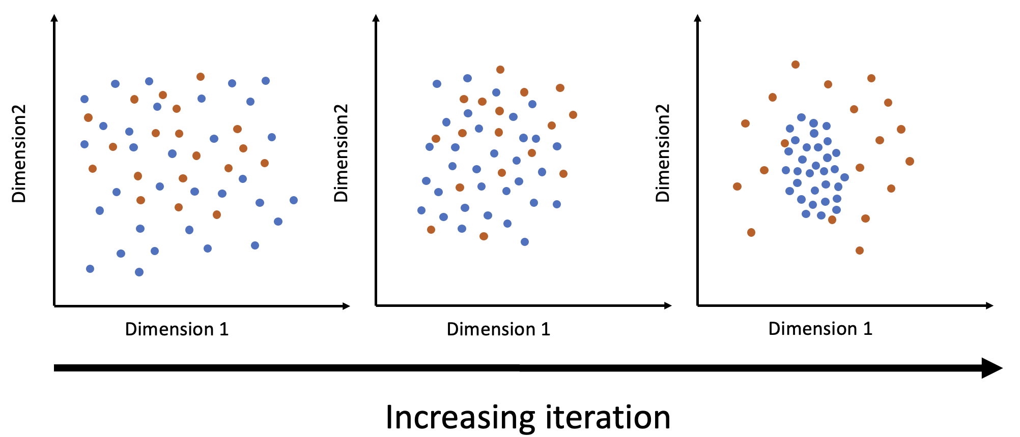
Present – PhD in Computational Neuroscience
Main Objectives
How do we study it?
1. Temporal Dynamics of Sensory Representation
Neural data analysis (IC and A1)
Computational modelling
Individual tones
One sequence
Spike sorting and Dimensionality reduction techniques (e.g., PCA)
RNN autoencoder
Dynamical systems analysis
Latent State Representation and stability analysis
2. Noise Invariant Representation of Sound Sequences
Stability of sensory representation
Cross correlation, Granger Causality, Phase coherence
Network model between IC and A1 – study the effect of cortical inhibition on IC
3. Cortico-Collicular Interactions in Auditory Learning and Representation
Cortical inhibition on IC
Next steps → Two sequences (ambiguity), more naturalistic sounds
Theoretical/computational framework for unsupervised auditory contextual learning within IC and A1
Notes:
Task specific RNNs?
1. How are individual tones, when repeated in a specific sequence, initially represented in the auditory system, and how does this representation evolve as they are integrated into a cohesive sound sequence over time?
2. How is the representation of sound sequences maintained stably in the IC and AC while selectively attenuating the representation of noise?
3. In what ways do cortico-collicular interactions influence the learning and representation of auditory sequences?
Stability Analysis: Examining the stability of these trajectories, such as identifying fixed points (where the state ceases to change) and analyzing their stability (how the system behaves when perturbed slightly), can provide insights into the network’s ability to learn and generalize. For instance, stable fixed points may represent learned patterns or features of the data.
Why not input the sound sequences itself?
How many trials do I require minimum to train this RNN?
Provides a comprehensive view that combines neural activity data with dynamic modeling to elucidate the principles of auditory perception and learning. This framework not only complements experimental work by providing a means to interpret and predict neural behavior but also pushes forward the understanding of complex neural networks in a functionally relevant context.

Slide 23
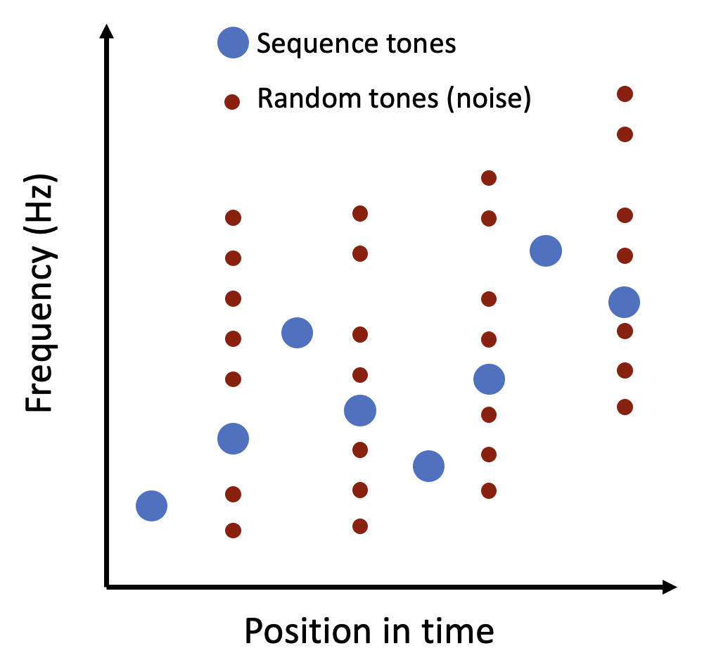

Slide 24
My Journey
Dimension2
Dimension2
Dimension2
Dimension 1
Dimension 1
Dimension 1
Increasing iteration
Notes:
A complex process such as contextual processing is likely to occur simultaneously at several interacting levels of the auditory system in a time- and task-dependent manner, possibly over progressively wider integration time-windows.

Slide 25
My Journey
Dimension2
Dimension2
Dimension2
Dimension 1
Dimension 1
Dimension 1
Increasing iteration
Notes:
A complex process such as contextual processing is likely to occur simultaneously at several interacting levels of the auditory system in a time- and task-dependent manner, possibly over progressively wider integration time-windows.

Slide 26
Present – PhD in Computational Neuroscience
Main Objectives
How do we study it?
1. Temporal Dynamics of Sensory Representation
Neural data analysis (IC and A1)
Computational modelling
Individual tones
One sequence
Spike sorting and Dimensionality reduction techniques (e.g., PCA)
RNN autoencoder
Dynamical systems analysis
Latent State Representation and stability analysis
2. Noise Invariant Representation of Sound Sequences
Stability of sensory representation
Cross correlation, Granger Causality, Phase coherence
Network model between IC and A1 – study the effect of cortical inhibition on IC
3. Cortico-Collicular Interactions in Auditory Learning and Representation
Theoretical/computational framework for unsupervised auditory contextual learning within IC and A1
Notes:
Task specific RNNs?
Stability Analysis: Examining the stability of these trajectories, such as identifying fixed points (where the state ceases to change) and analyzing their stability (how the system behaves when perturbed slightly), can provide insights into the network’s ability to learn and generalize. For instance, stable fixed points may represent learned patterns or features of the data.
Why not input the sound sequences itself?
How many trials do I require minimum to train this RNN?

Slide 27
My Journey
Present – PhD in Computational Neuroscience
deHoz Lab, Dr. Livia de Hoz
Temporal dynamics of unsupervised contextual learning in cortico-collicular loops
Foreground-background segregation
Background
Stable sequence representation
Inferior colliculus → unsupervised contextual learning
1. Filter out random background noise that is embedded within a series of sound sequences
Effective noise filtration
(Cruces-Solís et al., 2018, Chen et al., 2023)
2. Adapt to different background noises with stationary statistics (ventilation sound, waterfalls)
MUA within IC

Slide 28
Present – PhD in Computational Neuroscience
Main Objectives
How do we study it?
1. Temporal Dynamics of Sensory Representation
Neural data analysis (IC and A1)
Computational modelling
How are individual tones, when repeated in a specific sequence, initially represented in the auditory system, and how does this representation evolve as they are integrated into a cohesive sound sequence over time?
Spike sorting and Dimensionality reduction techniques (eg., PCA)
Train an autoencoder RNN on the sound evoked neural responses within IC and A1
Dynamical systems analysis on the trained RNN - Latent State Representation and stability analysis
2. Noise Invariant Representation of Sound Sequences
Cross correlation
Granger Causality
Phase coherence
How is the representation of sound sequences maintained stably in the IC and AC while selectively attenuating the representation of noise?
Network model between IC and A1 – study the effect of corticial inhibition on IC
3. Cortico-Collicular Interactions in Auditory Learning and Representation
In what ways do cortico-collicular interactions influence the learning and representation of auditory sequences?
Notes:
Task specific RNNs?
Stability Analysis: Examining the stability of these trajectories, such as identifying fixed points (where the state ceases to change) and analyzing their stability (how the system behaves when perturbed slightly), can provide insights into the network’s ability to learn and generalize. For instance, stable fixed points may represent learned patterns or features of the data.
Why not input the sound sequences itself?
How many trials do I require minimum to train this RNN?

Slide 29
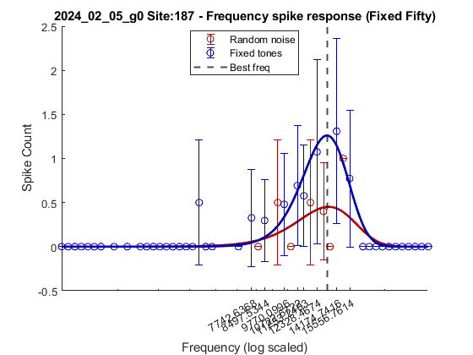
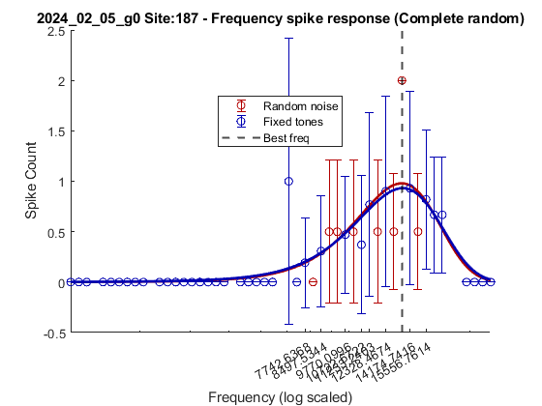
Present – PhD in Computational Neuroscience
Background
Main Objectives
How do we study it?
Inferior colliculus → unsupervised contextual learning
1. Temporal Dynamics of Sensory Representation
Neural data analysis (IC and A1)
(Cruces-Solís et al., 2018, Chen et al., 2023)
How are individual elements (tones), characterized by similar statistics and repeatability, initially represented in the auditory system, and how does this representation evolve as they are perceived as a cohesive sound sequence over time?
Spike sorting and Dimensionality reduction techniques (PCA)
MUA within IC
2. Noise Invariant Representation of Sound Sequences
Computational modelling
Effective noise filtration
Train an autoencoder RNN on the input sequence data
How is the representation of sound sequences maintained stably in the IC and AC while selectively attenuating the representation of noise?
Stable sequence representation
Dynamical systems analysis on the trained RNN
3. Cortico-Collicular Interactions in Auditory Learning and Representation
In what ways do cortico-collicular interactions influence the learning and representation of auditory sequences?
Notes:
Task specific RNNs?

Slide 30
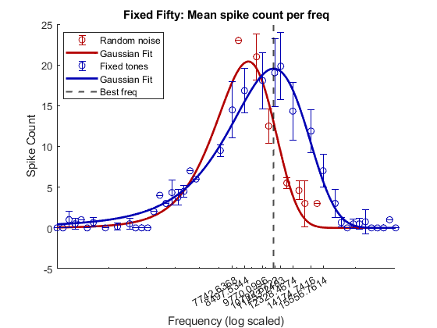
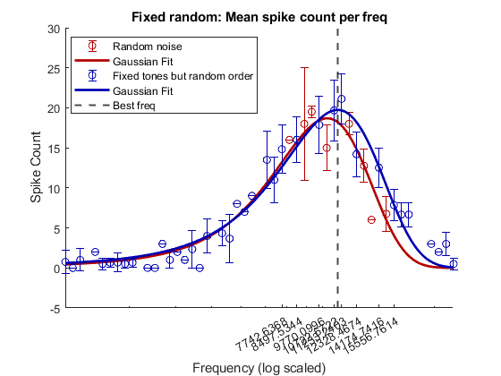
Present – PhD in Computational Neuroscience
Background
Main Objectives
How do we study it?
1. Temporal Dynamics of Sensory Representation
Neural data analysis (IC and A1)
How are individual elements (tones), characterized by similar statistics and repeatability, initially represented in the auditory system, and how does this representation evolve as they are perceived as a cohesive sound sequence over time?
Spike sorting and Dimensionality reduction techniques (PCA)
2. Noise Invariant Representation of Sound Sequences
Computational modelling
Train an autoencoder RNN on the input sequence data
How is the representation of sound sequences maintained stably in the IC and AC while selectively attenuating the representation of noise?
Dynamical systems analysis on the trained RNN
3. Cortico-Collicular Interactions in Auditory Learning and Representation
In what ways do cortico-collicular interactions influence the learning and representation of auditory sequences?
Notes:
Task specific RNNs?

Slide 31
Research experience
Offline spike sorting
How does altering single-cell and population-level activity affect a monkey’s working memory?
Learning and memory
Spatial audio setup with a software interface
Sensory perception
How does sound localization help in perceiving spatial audio?
How does sensory integration in a Gerbil’s auditory cortex guide an animal’s decision in a changing environment? (Auditory reversal learning)
Linear array of speakers
Cognitive flexibility
Time frequency analysis
Supervised learning – movement intention and movement
Clinical rehabilitation
Potential classification feature to design a brain-computer interface for post-stroke rehabilitation
Adaptive decision making
How do neuronal activity patterns in the frontal cortex shape an animal’s adaptive decision-making behaviour in a foraging task?
Master thesis

